Slide 1


School of Computing Science and Engineering
Course Code : R1UC604C Course Name: Deep Learning
Neural Networks
Name of the Faculty: Dr. Abdul Aleem Program Name: B.Tech

Slide 2
Outline
History of Artificial Neural Networks
Introduction
What is an Artificial Neural Networks?
How it works?
Learning
Applications areas
Advantages and Disadvantages
Name of the Faculty: Dr. Abdul Aleem Program Name: B.Tech

Slide 3
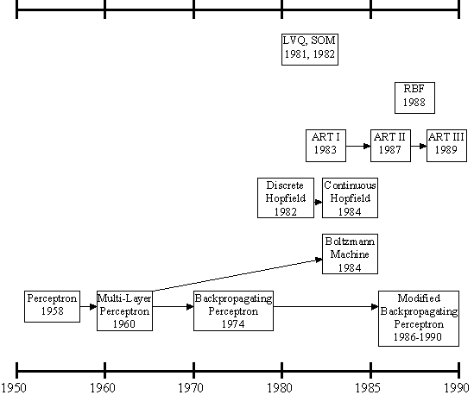
History
History of the ANNs stems from the 1940s, the decade of the first electronic computer.
However, the first important step took place in 1957 when Rosenblatt introduced the first concrete neural model, the perceptron. Rosenblatt also took part in constructing the first successful neurocomputer, the Mark I Perceptron. After this, the development of ANNs has proceeded as described in Figure.
Name of the Faculty: Dr. Abdul Aleem Program Name: B.Tech

Slide 4
History
Rosenblatt's original perceptron model contained only one layer. From this, a multi-layered model was derived in 1960. At first, the use of the multi-layer perceptron (MLP) was complicated by the lack of a appropriate learning algorithm.
In 1974, Werbos came to introduce a so-called backpropagation algorithm for the three-layered perceptron network.
Name of the Faculty: Dr. Abdul Aleem Program Name: B.Tech

Slide 5
History
In 1986, The application area of the MLP networks remained rather limited until the breakthrough when a general back propagation algorithm for a multi-layered perceptron was introduced by Rummelhart and Mclelland.
In 1982, Hopfield brought out his idea of a neural network. Unlike the neurons in MLP, the Hopfield network consists of only one layer whose neurons are fully connected with each other.
Name of the Faculty: Dr. Abdul Aleem Program Name: B.Tech

Slide 6
History
Since then, new versions of the Hopfield network have been developed. The Boltzmann machine has been influenced by both the Hopfield network and the MLP.
Name of the Faculty: Dr. Abdul Aleem Program Name: B.Tech

Slide 7
History
Broomhead & Lowe. Although the basic idea of RBF was developed 30 years ago under the name method of potential function, the work by Broomhead & Lowe opened a new frontier in the neural network community.
Name of the Faculty: Dr. Abdul Aleem Program Name: B.Tech

Slide 8
History
Since then, research on artificial neural networks has remained active, leading to many new network types, as well as hybrid algorithms and hardware for neural information processing.
Name of the Faculty: Dr. Abdul Aleem Program Name: B.Tech

Slide 9
What is Artificial Neural Network ?
Computational models inspired by the human brain:
Algorithms that try to mimic the brain.
Massively parallel, distributed system, made up of simple processing units (neurons)
Synaptic connection strengths among neurons are used to store the acquired knowledge.
Knowledge is acquired by the network from its environment through a learning process
Name of the Faculty: Dr. Abdul Aleem Program Name: B.Tech

Slide 10
What is Artificial Neural Network?
The term "Artificial Neural Network" is derived from Biological neural networks that develop the structure of a human brain.
Similar to the human brain, artificial neural networks also have neurons that are interconnected to one another in various layers of the networks.
These neurons are known as nodes.
Each neuron is made up of a cell body that is responsible for processing information by carrying information towards (inputs) and away (outputs) from the brain
Name of the Faculty: Dr. Abdul Aleem Program Name: B.Tech

Slide 11
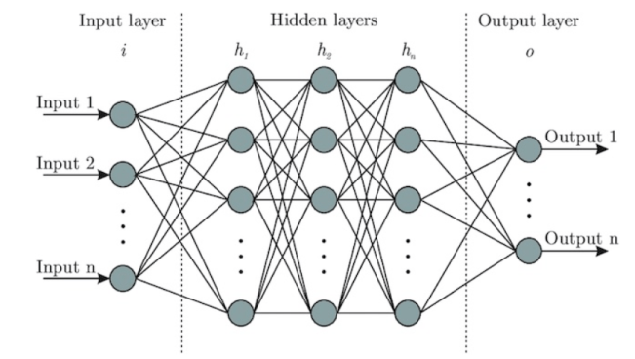
What is Artificial Neural Network?
Neural Networks are multi-layered networks consisting of neurons or nodes. These neurons are the core processing units of the neural network.
They are designed to act like human brains.
They take in data, train themselves to recognize the patterns in the data and then predict the output.
A basic neural network has three layers:
Input layer
Hidden layer
Output layer
Name of the Faculty: Dr. Abdul Aleem Program Name: B.Tech

Slide 12
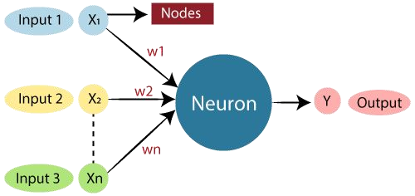
ANN Neuron
Name of the Faculty: Dr. Abdul Aleem Program Name: B.Tech

Slide 13
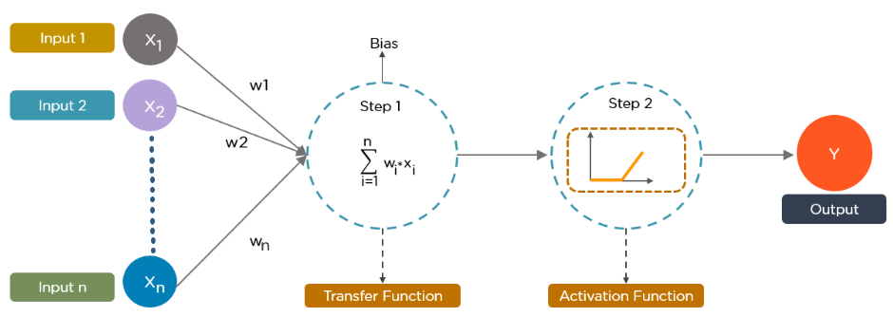
Architecture of ANN
Name of the Faculty: Dr. Abdul Aleem Program Name: B.Tech

Slide 14
Biological Neural Network (BNN)
Dendrites − they are tree-like branches, responsible for receiving the information from other neurons it is connected to. In other sense, we can say that they are like the ears of neuron.
Soma − It is the cell body of the neuron and is responsible for processing of information, they have received from dendrites.
Axon − It is just like a cable through which neurons send the information.
Synapses − It is the connection between the axon and other neuron dendrites
Name of the Faculty: Dr. Abdul Aleem Program Name: B.Tech

Slide 15
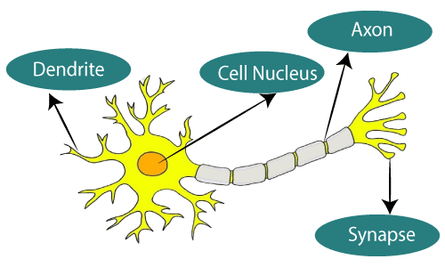
BNN Representation
Name of the Faculty: Dr. Abdul Aleem Program Name: B.Tech

Slide 16
Biological Neural Network and ANN
Biological Neural Network | Artificial Neural Network
Dendrites | Inputs
Cell nucleus | Nodes
Synapse | Weights
Axon | Output
Name of the Faculty: Dr. Abdul Aleem Program Name: B.Tech

Slide 17
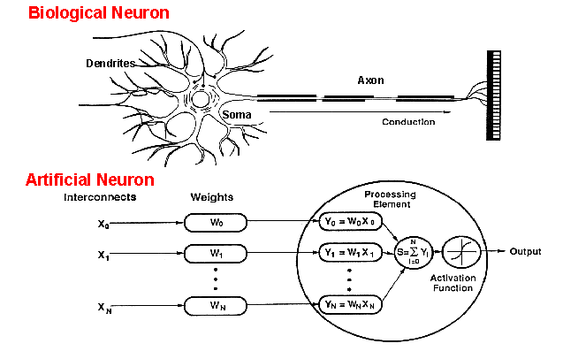
BNN Versus ANNs
An artificial neuron is an imitation of a human neuron
Name of the Faculty: Dr. Abdul Aleem Program Name: B.Tech

Slide 18
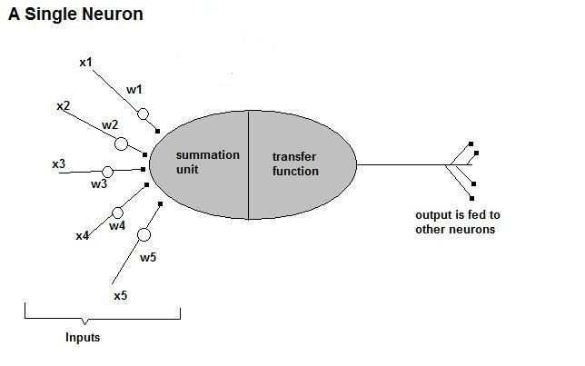
How does ANNs work?
Now, let us have a look at the model of an artificial neuron
Name of the Faculty: Dr. Abdul Aleem Program Name: B.Tech

Slide 19
Working of ANN
An artificial neuron is an imitation of a human neuron
Input
xm
. . . . . . . . . . . .
x2
x1
Processing
∑
∑= X₁+X₂ + ….+X_{m} =y
Output
y
Name of the Faculty: Dr. Abdul Aleem Program Name: B.Tech

Slide 20

Working of ANN Cont’d …
Not all inputs are equal
xm
. . . . . . . . . . . .
x2
x1
Input
w_{m}
w₂
w₁
. . . . .
∑
Processing
∑= X₁w₁+X₂w₂ + ….+X_{m}w_{m} =y
Output
y
Name of the Faculty: Dr. Abdul Aleem Program Name: B.Tech

Slide 21

Working of ANN Cont’d …
The signal is not passed down to the next neuron verbatim
xm
. . . . . . . . . . . .
x2
x1
Input
w_{m}
w₂
w₁
weights
. . . . .
Processing
∑
Transfer Function (Activation Function)
f(v_{k})
Output
y
Name of the Faculty: Dr. Abdul Aleem Program Name: B.Tech

Slide 22
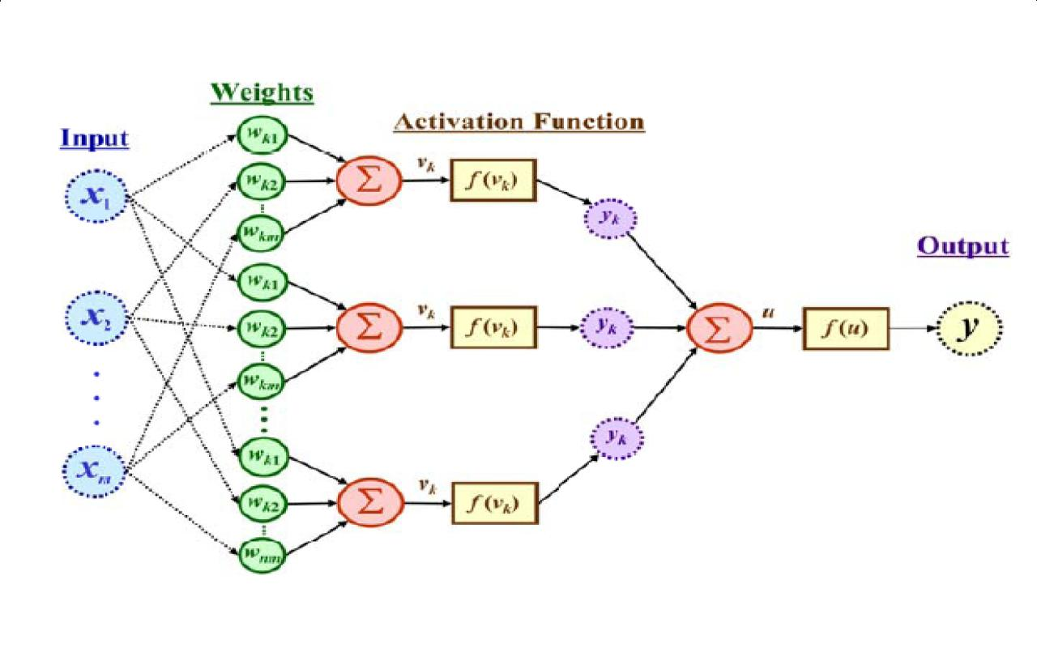
Working of ANN Cont’d …
The output is a function of the input, that is affected by the weights, and the transfer functions
Name of the Faculty: Dr. Abdul Aleem Program Name: B.Tech

Slide 23
Weights Adjusting
After each iteration, weights should be adjusted to minimize the error.
– All possible weights
– Back propagation
Name of the Faculty: Dr. Abdul Aleem Program Name: B.Tech

Slide 24
Transfer Function
The artificial neural network takes input and computes the weighted sum of the inputs and includes a bias.
This computation is represented in the form of a transfer function.
It determines weighted total is passed as an input to an activation function to produce the output.
Activation functions choose whether a node should fire or not. Only those who are fired make it to the output layer.
Details about Activation Functions to be discussed in Deep Learning.
Name of the Faculty: Dr. Abdul Aleem Program Name: B.Tech

Slide 25
Types of Transfer Functions
Linear: The output is proportional to the total weighted input.
Threshold: The output is set at one of two values, depending on whether the total weighted input is greater than or less than some threshold value.
Non‐linear: The output varies continuously but not linearly as the input changes.
Name of the Faculty: Dr. Abdul Aleem Program Name: B.Tech

Slide 26
Number of Neurons
Many neurons:
Higher accuracy
Slower
Risk of over‐fitting
Memorizing, rather than understanding
The network will be useless with new problems.
Few neurons:
Lower accuracy
Inability to learn at all
Optimal number.
Name of the Faculty: Dr. Abdul Aleem Program Name: B.Tech

Slide 27
Data Representation
Usually input/output data needs pre‐processing
Pictures
Pixel intensity
Text:
A pattern
Name of the Faculty: Dr. Abdul Aleem Program Name: B.Tech

Slide 28
Size of Training Set
No one‐fits‐all formula
Over fitting can occur if a “good” training set is not chosen
What constitutes a “good” training set?
Samples must represent the general population.
Samples must contain members of each class.
Samples in each class must contain a wide range of variations or noise effect.
The size of the training set is related to the number of hidden neurons
Name of the Faculty: Dr. Abdul Aleem Program Name: B.Tech

Slide 29
Types of Artificial Neural Network
Feedforward Neural Network – Artificial Neuron
Radial basis function Neural Network
Kohonen Self Organizing Neural Network
Recurrent Neural Network(RNN) – Long Short Term Memory (LSTM)
Convolutional Neural Network
Modular Neural Network
Name of the Faculty: Dr. Abdul Aleem Program Name: B.Tech

Slide 30
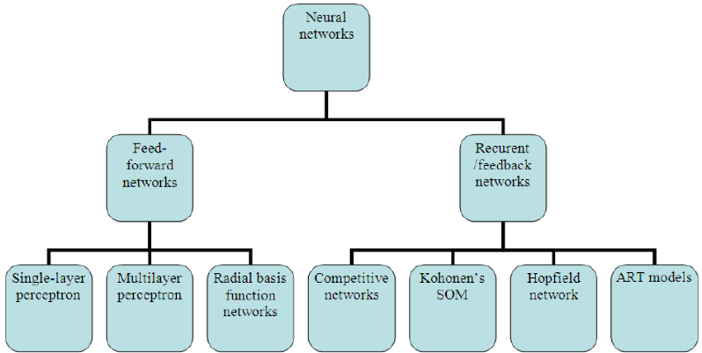
Types of ANN
Name of the Faculty: Dr. Abdul Aleem Program Name: B.Tech

Slide 31
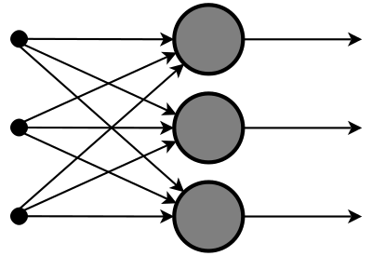
Feed Forward Neural Network
It is one of the simplest forms of ANN, where the data or the input travels in one direction. The information flow is unidirectional.
The data passes through the input nodes and exit on the output nodes.
This neural network may or may not have the hidden layers.
It has a front propagated wave only and usually does not have Back propagation.
Name of the Faculty: Dr. Abdul Aleem Program Name: B.Tech

Slide 32
Application of Feed Forward Neural Networks
Data Compression
Pattern Recognition
Computer Vision
Sonar Target Recognition
Speech Recognition
Handwritten Characters Recognition
Name of the Faculty: Dr. Abdul Aleem Program Name: B.Tech

Slide 33
Backpropagation
Back-propagation is an example of supervised learning is used at each layer to minimize the error between the layer’s response and the actual data
The error at each hidden layer is an average of the evaluated error
Hidden layer networks are trained this way
Name of the Faculty: Dr. Abdul Aleem Program Name: B.Tech

Slide 34
Backpropagation
Backpropagation is one of the important concepts of a neural network. Our task is to classify our data best. For this, we have to update the weights of parameter and bias, but how can we do that in a deep neural network? In the linear regression model, we use gradient descent to optimize the parameter. Similarly here we also use gradient descent algorithm using Backpropagation.
For a single training example, Backpropagation algorithm calculates the gradient of the error function. Backpropagation can be written as a function of the neural network. Backpropagation algorithms are a set of methods used to efficiently train artificial neural networks following a gradient descent approach which exploits the chain rule.
Name of the Faculty: Dr. Abdul Aleem Program Name: B.Tech

Slide 35
Backpropagation Cont’d …
The main features of Backpropagation are the iterative, recursive and efficient method through which it calculates the updated weight to improve the network until it is not able to perform the task for which it is being trained. Derivatives of the activation function to be known at network design time is required to Backpropagation.
Now, how error function is used in Backpropagation and how Backpropagation works? Let start with an example and do it mathematically to understand how exactly updates the weight using Backpropagation.
Name of the Faculty: Dr. Abdul Aleem Program Name: B.Tech

Slide 36
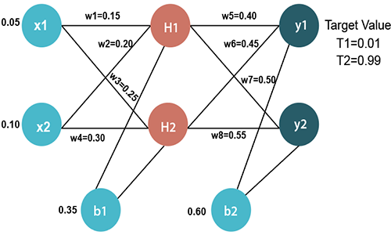
Backpropagation Cont’d …
Name of the Faculty: Dr. Abdul Aleem Program Name: B.Tech

Slide 37
Backpropagation Cont’d …
Input values
X1=0.05 X2=0.10
Initial weight
W1=0.15 w5=0.40 W2=0.20 w6=0.45 W3=0.25 w7=0.50 W4=0.30 w8=0.55
Bias Values
b1=0.35 b2=0.60
Target Values
T1=0.01 T2=0.99
Name of the Faculty: Dr. Abdul Aleem Program Name: B.Tech

Slide 38
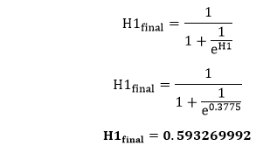
Backpropagation Cont’d …
Now, we first calculate the values of H1 and H2 by a forward pass.
Forward Pass
2. To find the value of H1 we first multiply the input value from the weights as
H1=x1×w₁+x2×w₂+b1 H1=0.05×0.15+0.10×0.20+0.35 H1=0.3775
3. To calculate the final result of H1, we performed the sigmoid function as
Name of the Faculty: Dr. Abdul Aleem Program Name: B.Tech

Slide 39
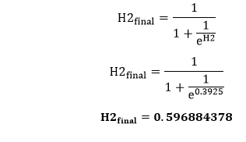
Backpropagation Cont’d …
We will calculate the value of H2 in the same way as H1
H2=x1×w₃+x2×w₄+b1 H2=0.05×0.25+0.10×0.30+0.35 H2=0.3925
2. To calculate the final result of H1, we performed the sigmoid function as
Name of the Faculty: Dr. Abdul Aleem Program Name: B.Tech

Slide 40
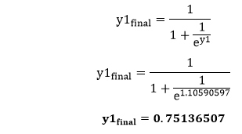
Backpropagation Cont’d …
Now, we calculate the values of y1 and y2 in the same way as we calculate the H1 and H2.
To find the value of y1, we first multiply the input value i.e., the outcome of H1 and H2 from the weights as
y1=H1×w₅+H2×w₆+b2 y1=0.593269992×0.40+0.596884378×0.45+0.60 y1=1.10590597
3. To calculate the final result of y1 we performed the sigmoid function as
Name of the Faculty: Dr. Abdul Aleem Program Name: B.Tech

Slide 41
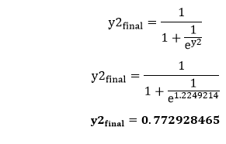
Backpropagation Cont’d …
1. We will calculate the value of y2 in the same way as y1
y2=H1×w₇+H2×w₈+b2 y2=0.593269992×0.50+0.596884378×0.55+0.60 y2=1.2249214
2. To calculate the final result of y2, we performed the sigmoid function as
Name of the Faculty: Dr. Abdul Aleem Program Name: B.Tech

Slide 42

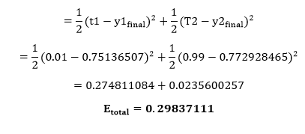
Backpropagation Cont’d …
Our target values are 0.01 and 0.99. Our y1 and y2 value is not matched with our target values T1 and T2.
Now, we will find the total error, which is simply the difference between the outputs from the target outputs. The total error is calculated as
Name of the Faculty: Dr. Abdul Aleem Program Name: B.Tech

Slide 43
Properties of ANN
High level abstraction of neural input-output transformation
Inputs → weighted sum of inputs → nonlinear function → output
Typically no spikes
Typically use implausible constraints or learning rules
Often used where data or functions are uncertain
Goal is to learn from a set of training data
And to generalize from learned instances to new unseen data
Key attributes
Parallel computation
Distributed representation and storage of data
Learning (networks adapt themselves to solve a problem)
Fault tolerance (insensitive to component failures)
Name of the Faculty: Dr. Abdul Aleem Program Name: B.Tech

Slide 44
Application of ANN
Artificial neural networks are used for a range of applications,
including image recognition,
speech recognition,
machine translation,
medical diagnosis.
Name of the Faculty: Dr. Abdul Aleem Program Name: B.Tech

Slide 45
Advantages/ Disadvantages of ANN
Advantages
Adapt to unknown situations
Powerful, it can model complex functions.
Ease of use, learns by example, and very little user domain‐specific expertise needed
Disadvantages
Forgets
Not exact
Large complexity of the network structure
Name of the Faculty: Dr. Abdul Aleem Program Name: B.Tech

Slide 46


